Slide 1
My Career Choice
Architectural Design
Ron Ross

Slide 2
Introduction
Include name of the career you have chosen.
Why did you choose that career?
What appeals to you about this career?

Slide 3
Introduction
I have chosen Architectural Design as my Career.
I have always loved drawing, architecture, and problem solving.
My Career Cluster Inventory from Ohio Means Jobs indicates my strengths in Arts and Information Technology.
I love the idea of creating something that might last hundreds of years.

Slide 4
The Job
What does someone in this career do?
What are the daily duties and expectations for this job? (List at least 3 and explain them).
What would you consider the best parts of the day?
What would be the most challenging?

Slide 5
The Job

Slide 6
The Job
According to the TargetJobs website. https://targetjobs.co.uk/careers-advice/job-descriptions/277573-architect-job-description Architects create designs for new projects and redevelopments. An Architect stays involved during the entire construction process.
Duties . According to the website typical work activities include:
Creating very detailed drawings and designs of buildings. Designs are made by hand or using Computer-aided-Design programs.
Must communicate and work with construction professionals about the possibility of potential projects
Must work with government officials for zoning and environmental impact as well as prepare budgets.

Slide 7
The Job
Duties (continued). According to the website:
Must make applications for permitting and building.
Must prepare documents regarding jobs
Choose materials and specifications for jobs.
Make adjustments to plans based on circumstances.
Keep a schedule.
Travel to various sites on a regular basis.

Slide 8
Required Skills
Required skills: What are the skills, talents or personality traits required for this job? How do your interests fit with this career?
In what ways are you suited for this career? (use the information from your surveys, both paper and Ohio Means Jobs) What personality characteristics or skills do you currently possess that you believe will benefit you in this career? (Use your Ohio Means Jobs Personality test as a source)

Slide 9
Required Skills
According to OhioMeansJobs.com, the required skills for this position include:
Critical Thinking: ”Using logic and reasoning to identify the strengths and weaknesses of alternative solutions, conclusions or approaches to problems.”
Speaking ”Talking to others to convey information effectively.”
Active Listening ”Giving full attention to what other people are saying, taking time to understand the points being made, asking questions as appropriate, and not interrupting at inappropriate times.”

Slide 10
Required Education
What are the educational requirements for this job? How many years of study are involved? Where would you obtain this education? (On-the-job training, junior college, technical school, college or university?) List two schools that provide this training.

Slide 11
Required Education
According to Ohio Means Jobs website:
The typical education requirement for an architect is a bachelor’s degree.
There is no experience necessary but there is typically an internship/residency.
possess

Slide 12
Earnings
Earnings: What is the salary range for this career? What factors affect how much you earn (commission, location, education, etc.)? What is the usual entry level position into this field? What expenses, other than educational, are involved in getting set up in this career ?

Slide 13
Earnings
According to Ohio Means Jobs
The average salary for an architect is about $74,000 per year.
Factors that affect earnings include
Size of Architectural Firm
Location of Firm (Larger City= More $)
Entry Level jobs are usually at the intern Level.
Graph from Ohio Means Jobs.com

Slide 14
Conclusion
Conclusion:
What do you like about this career choice? In what setting would you like to have this career? (locally, out of state, big company, small, etc.?)
What are some Job Satisfaction requirements that are important to you when considering this career? (Use your Job Satisfaction Survey)
What is the Job Market like for your career choice?

Slide 15
Conclusion

Slide 16
Conclusion
Work Environment. I work best in a work environment that is less structured and more flexible. I would struggle with a manufacturing environment that is very rigid. I fit in best in a professional environment. I have greater job satisfaction when my work is varied and challenging. (rather than having a constant routine.) I have greater job satisfaction when I can be creative. I can survive on the very limited salary potential of a teacher. It is important that my job be a highly stable position. I do not work well in a cubicle. Although I enjoy working independently, I work best when I collaborate with others. I enjoy being outdoors occasionally.

Slide 17
Conclusion
The job of Architect suites my personality and gives me a chance to be creative as well as technical.
Outlook:
The job outlook for Architects is about average.
According to the Department of Labor. The number of jobs in 2014 was 112,600 and the growth rate for the job was expected to be 7% (As fast as average)

Slide 18
Works Cited
Citations and Quotes: The majority of this presentation will be paraphrased; however, you will need to use parenthetical citations and a few quotes to support your statements. These will be included in your Works Cited slides.
Sources: You will be required to have three sources for your paper.
Internet source
Author (if none, leave it blank)
Title Name of web page year/ month/day published (if none listed, leave it blank) year/month/date accessed (this is the date you looked at the information) URL (This is what is listed in the address box. Only list this until the .com, .org, .net or .edu)
Book source Author (if none, leave it blank) Title of book year published city published Publisher

Slide 19
Works Cited
“Architect: Job Description.” Targetjobs 15 Mar. 2016.
< https://targetjobs.co.uk/careers-advice/job-descriptions/277573-architect-job-description>.
“Architects, Except Landscape and Naval” Ohiomeansjobs.com. 15 Mar. 2016, < https://jobseeker.k-12.ohiomeansjobs.monster.com/ExploreIt/CareerDetails.aspx?usertype=&code=17101100 >.
“Occupational Outlook Handbook” Bureau of Labor Statistics. 15 Mar. 2016, http://www.bls.gov/ooh/architecture-and-engineering/architects.htm>.

Slide 20
Screen Shots

Slide 21
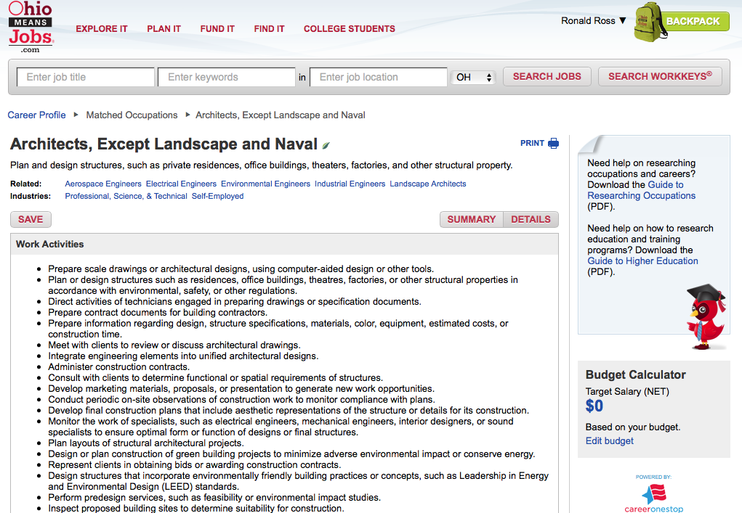
Screen Shots

Slide 22
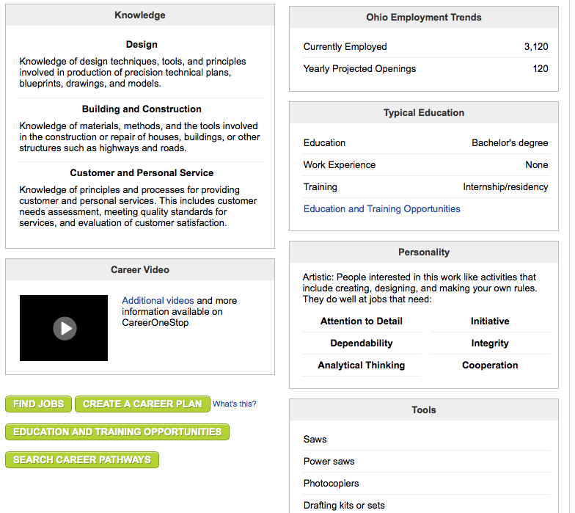
Screen Shots

Slide 23
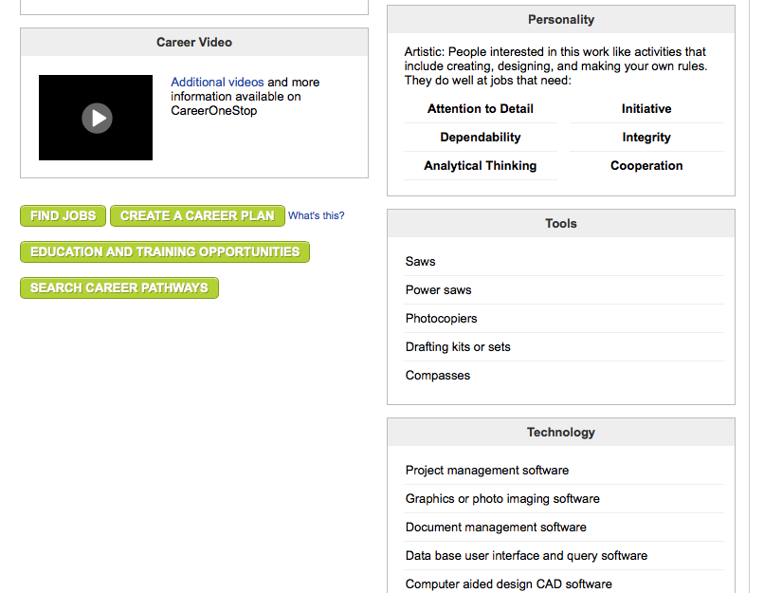
Screen Shots

Slide 24
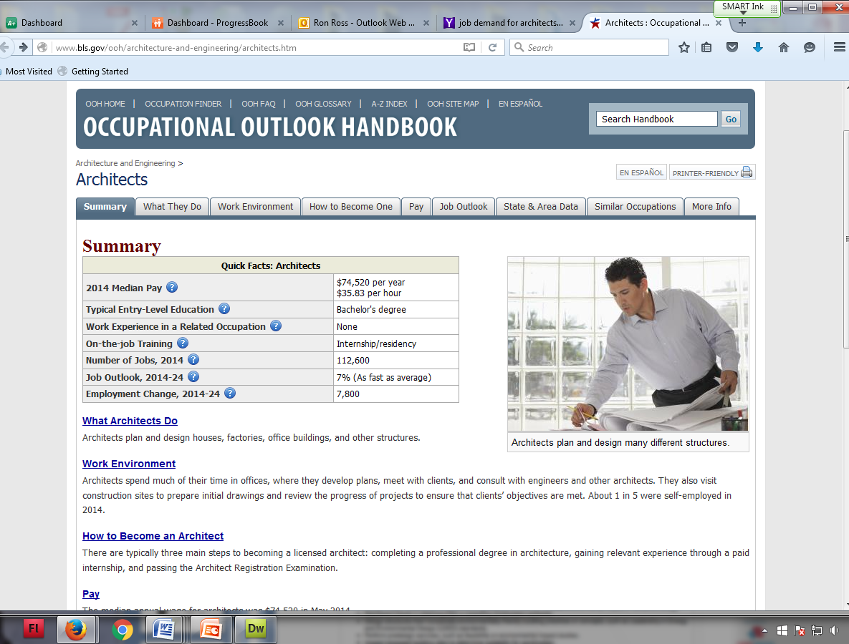
Screen Shots

